Slide 1
Immersed in the Sounds of Space
Space Apps Challenge 2023

Slide 2
Challenge Accepted
1 in 3 people worldwide are impacted by vision impairments
Team StarScream wanted to use sonication to turn space exploration into an audio-visual experience
Notes:
Space exploration has predominantly been enjoyed through visual means

Slide 3
Cosmic Harmony
An audio/visual trip through space
Adds an auditory layer to NASA fly-through videos:
Assist the visually-impaired
Enhance overall enjoyment of the watching experience

Slide 4
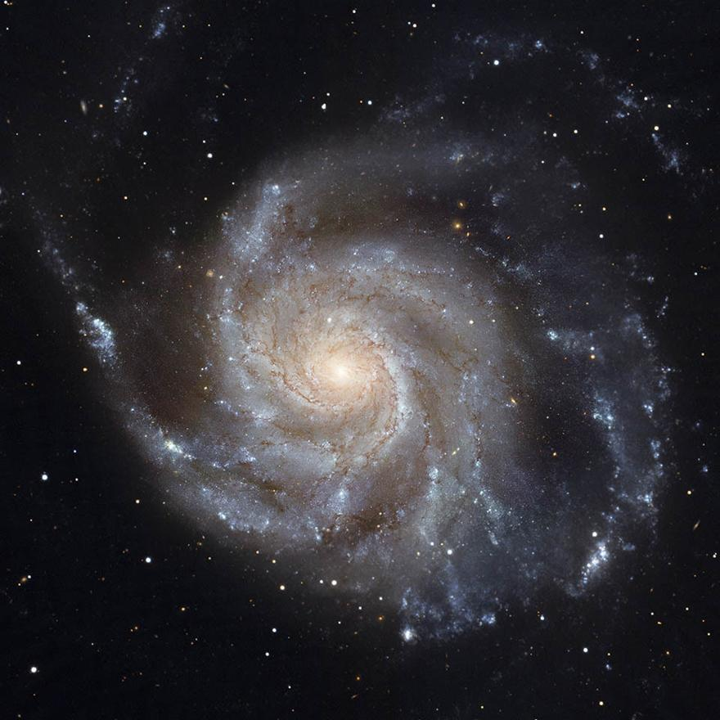
Team StarScream uses sonication to turn space exploration into an audio-visual experience

Slide 5
Can someone please insert the waveform video in the Google drive link below
https://drive.google.com/file/d/1Mtvbg5wNVeu8GjTKA-ImuQZYBj0bR-du/view?usp=drivesdk

Slide 6
Team StarScream
Jaydeep Mistry
Rayman Jamal
Tochi Oramasionwu
Jonathan Ong

Slide 7
Citations
1 in 3 people worldwide are impacted by vision impairments
World Health Organization. (n.d.). Blindness and vision impairment. ¹
Source: Conversation with Bing, 10/8/2023
(1) Cognitive Impairment in Older Adults With Concurrent Hearing and Vision .... https://www.frontiersin.org/articles/10.3389/fpsyt.2021.661560/full.
(2) Students With Disabilities - National Center for Education Statistics .... https://nces.ed.gov/programs/coe/pdf/2021/cgg_508c.pdf.
(3) Visual impairments. - APA PsycNet. https://psycnet.apa.org/record/1998-06548-010.
(4) Protocol for the development of versions of the Montreal Cognitive .... https://bmjopen.bmj.com/content/9/3/e026246.
(5) undefined. https://doi.org/10.3389/fpsyt.2021.661560.

